Slide 1
CS Final project
by:
Rassas mohamed mouayad
Alioua mohamed ghaith
Ahmed mohamed ashref zohdi
Belaam mohamed rayan
Huweidi elzubeir hatem

Slide 2
Topic
Our project aims to help the digitization of gyms by taking care of the members and coaches. This program contributes to the handling of the different courses but also from an administrative perspective, it allows to manage the registration fees etc.

Slide 3
Functionalities
calculateFees : to calculate the registration fees
toString: displays a message
copyList: function to copy the index from the constructor to filled slot index
resetCalender: Reset the calendar
addCLassesToSchedule: not implemented
updateClassSchedule: remake the schedule with an index of the slots you want
All Getters and Setters of: Salary/Designation/Fee/Type/FirstName/LastName/Email/DOB/StartDate/EndDate

Slide 4
What we learned
Use of Java in a more complex level.
Implementation of Lists in Java.
Anonymous implementation of Classes.
JavaFX.
Lambda.
Writing objects to files and reading objects from files.

Slide 6
Difficulties and Thing We learnt
Needed a way to represent a schedule => Learnt about Two Dimensional Arrays.
boolean[][] WeeklySchedule = new boolean[7][72];
First dimension: number of days in a week. Second dimension: represents 72, 15min time slots starting from 6am until 12am
Needed a variable to pass to a method that fills this WeeklySchedule array
needs to be a list of addresses that refer to the WeeklySchedule, like [0][0] refers to Monday from 6am - 6:15am, and [1][1] refers to Tuesday from 6:15-6:30am
So the structure looks something like this {[1,0], [0,1], [3,5], …}
Did research and learnt about ArrayLists to create:
public List<int[]> filledSlotsIndex = new ArrayList<int[]>();

Slide 7
Difficulties and Thing We learnt
ArrayLists can be appended dynamically: ArrayLists do not have to have a definite memory allocation like normal arrays when they are declared, they can be appended upon runtime. This saves unnecessary memory usage by the program.
The insertion and searching implementations of ArrayLists are stronger than normal arrays and provide more efficiency.

Slide 8
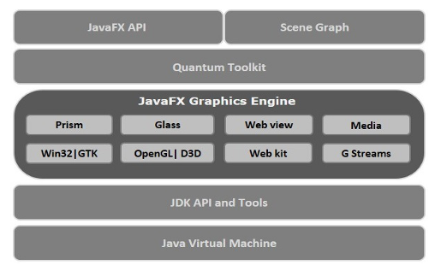
Difficulties and Thing We learnt GUI with JAVAFX
Java Fx is a framework for making guis. basically a library
Prism: rendering 2D and 3D graphics
WebView: allows you to embed HTML content in ot a scene graph
Media Engine: Audio and Video
GWT: Glass Windowing Toolkit provides services to mnage Windows, Timers, surfaces, Event Ques. the connection between JavaFX and the operating System…

Slide 9
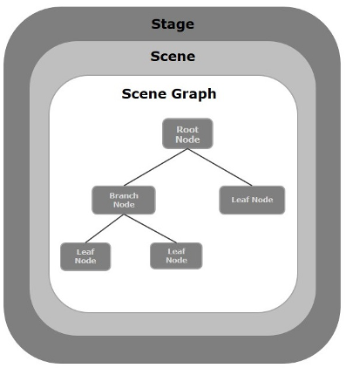
Difficulties and Thing We learnt GUI with JAVAFX
JavaFX Scene Graph
In general, a JavaFX application will have three major components namely Stage, Scene and Nodes as shown in the following diagram.

Slide 10
GUI Code And DEMO
Go Over the Code Sections in Main
Anonymous Implementation of Classes
Lambda Expression
XML
Scene Builder
Controller Classes

